Slide 1


Spark Interview Questions Accumulators in Spark

Slide 2
Why Accumulators
How Spark Works : Normally, when a function passed to a Spark operation (such as map or reduce) is executed on a remote cluster node, it works on separate copies of all the variables used in the function. These variables are copied to each machine, and no updates to the variables on the remote machine are propagated back to the driver program.
However, supporting general, read-write shared variables across tasks would be inefficient.
But at the same time, many a times ,a variable needs to be shared across tasks, or between tasks and the driver program. This is where Accumulators are used.
For parallel processing, Spark uses shared variable like Accumulators, a copy of shared variable goes on each node of the cluster when the driver sends a task to the executor on the cluster, so that it can be applied with different operations like add to counter ,sum etc..

Slide 3
What is Accumulator
Accumulators are variables that are used for aggregating information across the executors.
Accumulators are variables that are only “added” to like Counter and sum.
Accumulators are applicable to any operation which are:
Commutative -> f(x, y) = f(y, x)
Associative -> f(f(x, y), z) = f(f(x, z), y) = f(f(y, z), x)
For example, sum and max functions satisfy the above conditions whereas average does not.

Slide 4
Key features of Accumulator
Spark natively supports accumulators of numeric types, and programmers can add support for new types.
If accumulators are created with a name, they will be displayed in Spark’s UI.
Tracking accumulators in the UI can be useful for understanding the progress of running stages.
An accumulator is created from an initial value v by calling SparkContext.accumulator(v). Tasks running on the cluster can then add to it using the add method.
However, tasks running on cluster cannot read Accumulator’s value. Only the driver program can read the accumulator’s value, using its value method.

Slide 5
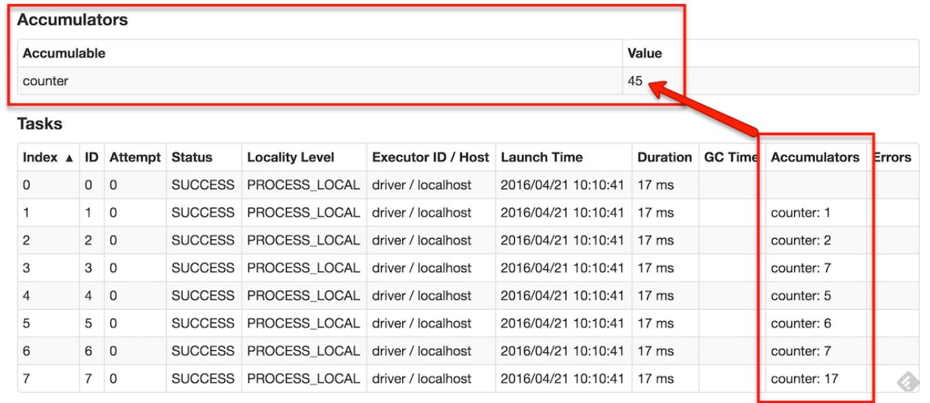
Accumulators on Spark UI

Slide 6
Thanks and do subscribe to my channel

